Slide 1

34359 – Software Defined Networking (SDN)
1/7 Course Overview & Introduction
34359 –Software Defined Networking (SDN)
Project 10: Authentication Service
Ashutosh Dhaka: s222374@dtu.dk
Pietro Marrone: s231987@dtu.dk
DTU Electro
1

Slide 2
Contents
Introduction to Authentication for web hosts
How the Application works
FLASK – Web Application
ONOS – The hub for controllers and switches
REST API – The way FLASK and ONOS server communicates
Service Authentication Workflow
Testing

Slide 3
What is Authentication Service?
Authentication Service verifies the credentials of a host.
This process is managed through a web interface in our case using a FLASK Server
The web server communicates with the network controller (ONOS) via its REST API provided with ONOS.
IMPORTANCE
Authentication service ensures only authorized hosts or users can access the network.
This process prevents unauthorized access and protects the network from potential threats.
It is a basic authorization that most services use.

Slide 4
Working of our application
Our application consists of two main components: Flask and ONOS. These components work together to provide network authentication and topology management.
Our application consists of 3 working components
Mininet – Virtual topology simulator
ONOS – Open Network Operating System
Flask – python based micro web framework
Flask
ONOS
Mininet

Slide 5
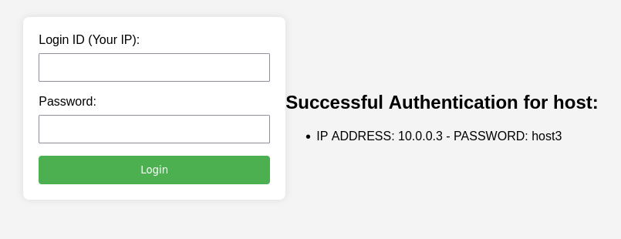
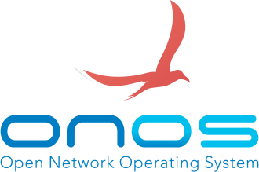

Understanding the
working elements
Flask server UI for authentication
Sits at the interface of ONOS and MININET,
Higher overview of controller and Topology

Slide 6
Flask Server
Developed using python3.
Micro web framework for lightweight web interfacing.
The user / host interacts with the flask server running locally (127.0.0.1:5000)
127.0.0.1:5000/login is where the user authenticates to enable communication with the network.

Slide 7
ONOS
ONOS Server offers the following features
Network Topology Management: ONOS is a centralized network operating system that manages the network topology. It keeps track of devices (switches and hosts) in the network and their interconnections.
REST APIs for Interaction: ONOS exposes REST APIs that enable external systems, such as Flask, to interact with it. These APIs provide functionalities to retrieve information about the network, make changes to the topology, and perform various network-related operations.
The flask server (127.0.0.1:5000) and ONOS Server(127.0.0.1:8181) communicate using POST and GET methods (basic HTTP protocols).
The packets generally compose of JSON packets.

Slide 8
Mininet
Mininet is an open-source network emulator that allows you to create virtual networks.
It helps in testing, prototyping, and experimenting with network designs without the need for physical hardware.
Creates virtual hosts, switches, controllers, and links, enabling users to simulate various network topologies and configurations.
Here we use Mininet to try our authorization services on various topologies to test for the robustness of the application.

Slide 9
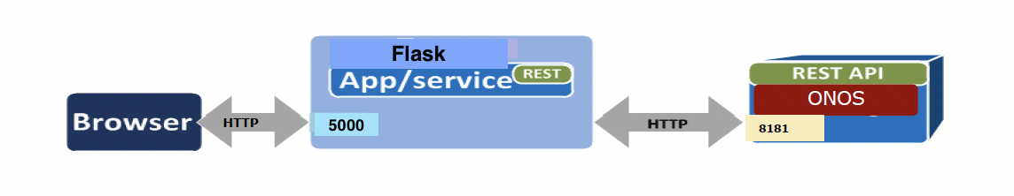
Communication Between Flask and ONOS
Flask and ONOS communicate through the REST APIs provided by ONOS. Flask sends requests to ONOS to retrieve information about the network and perform oprerations on flow rules and alter the working withing the toplogy.
ONOS processes these requests, performs the necessary operations, and sends back the relevant information or status to Flask.
This communication allows Flask to present real-time network information to users, handle authentication, and interact with the network managed by ONOS.

Slide 10
Application design considerations
ONOS and Mininet was taught during the course and provided a solid base to test our application
Flask was used as it is lightweight and easier to develop on using python.
Glassfish and java-based approach had a steep programming competence requirement.
CURL was also not used due to native terminal-based approach and error prone environment and should be used for field testing and not for making big applications.

Slide 11
Project structure
SDN
Templates
Login.html – FLASK renders this and user interacts using this HTML page
login.py – integration between flask server calls and requests about topology information.
mngtopo.py – interface between flask server calls and ONOS class (JSON manipulation)
customclass.py – class composing of ONOS object that packs and unpacks JSON files to POST and GET using REST API calls.
Topologies
Contains the topologies we have tested on (tree, ring, etc.)

Slide 12
Program flow
Start ONOS server -> start mininet topology (with OF switches) -> verify topology using ONOS UI.
Initially all the hosts are incapable of communicating over the network.
Start the FLASK server using 127.0.0.1:5000/login.
Entering the IP of the host and password initializes the host to send packets across network.
In the background we use the host IP to detect the switch it belongs to and update the flow rules for the IP (insert JSON image)
We check the packets using wireshark and repeat the process for all the host.
In the terminal stage the authenticated users can communicate over ONOS server using our application.

Slide 13
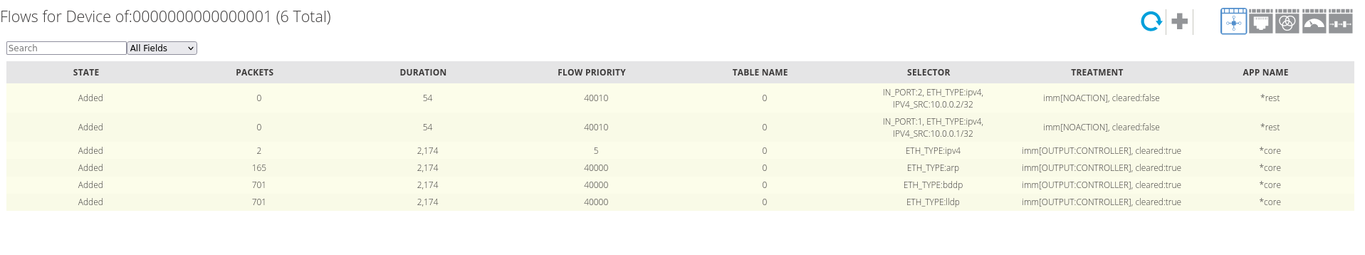
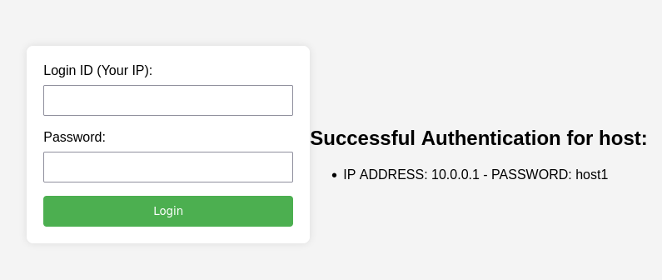
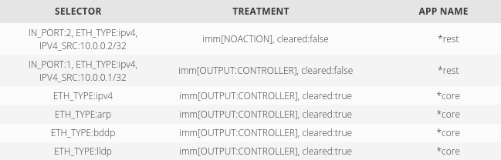
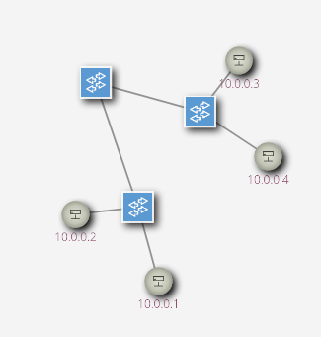
Switch 1 flows after initialization but no Login
Flask interface to login
Switch 1 flows after login
Current Running topology

Slide 14
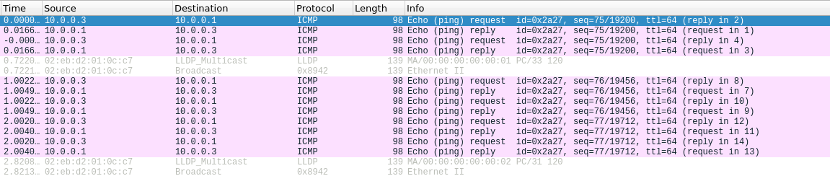
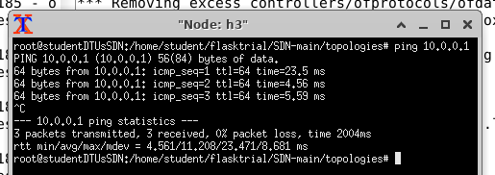
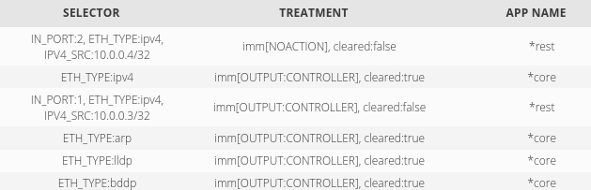
Packets from host 3 to host 1
host 3 Xterm output
Switch 3 flows

Slide 15
Accomplishments wrt project statement
No host can communicate when we initialize the topology
Host can communicate when authorized using correct credentials.
In case of incorrect credentials error logging in is printed on the web server.
Use of the topology given in the problem statement.
Tested with Ring, Tree and other topologies.

Slide 16
Use Cases
Enhance security and access control for network management.
Audit Trails and Accountability: By tying user actions to specific authenticated accounts, web-based authentication can help in creating audit trails, tracking changes, and holding users accountable for their actions within the network management system.
User Management and Provisioning: It simplifies user management by allowing administrators to add, modify, or remove user access to the ONOS server through centralized web-based authentication systems.
Integration with Web Interfaces: If you have a web-based interface for ONOS, implementing web-based authentication provides a seamless experience for users accessing the system through a web browser.
Compliance and Regulations: Certain industries or organizations may have compliance requirements that mandate strict access control and authentication mechanisms. Web-based authentication helps in meeting these compliance standards.

Slide 17
Future Scope
Adding features to logout
Adding a Role-Based Access Control (RBAC)
Integrating with other ONOS functionalities
Integrating with a better web framework to distribute workload between ONOS and web server.
Database based user authentication service.

Slide 18
Thank you for listening

